Slide 1

Chapter 1
K. K. Wagh Polytechnic, Nashik-3
Basics of JavaScript Programming
CO605.1: Create interactive web pages using program flow
control structure.

Slide 2
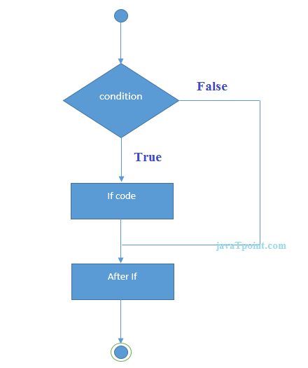
Flowchart of JavaScript If statement

Slide 3
Decision Making and Branching Cont.
if Statement
if (Condition) OR if (Condition)
{ statement(s); statement;
}
Condition contains Relational operators as well as Logical Operators.
Ex: if (i > 0)
{
- - - - - - - ;
}
if (i > 1 || j!=5)
{
- - - - - - - ;
}

Slide 4
Example :WAP JS of Find Greater Number
<script>
var a=20;
if(a>10){
document.write("value of a is greater than 10");
}
</script>

Slide 5
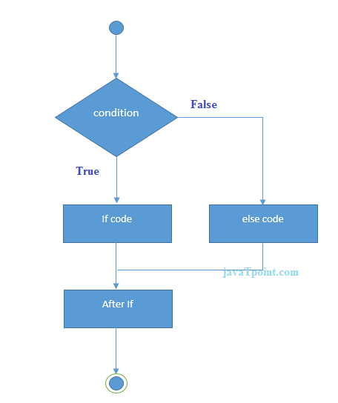
Flowchart of JavaScript If...else statement

Slide 6
Decision Making and Branching Cont.
2) if else Statement
if (condition)
{
stmt(s) for true case;
}
else
{
stmt(s) for true case;
}
Or
if (condition)
stmt for true case;
else
stmt for true case;

Slide 7
Example :WAP JS of Find Even or ODD
<script>
var a=20;
if(a%2==0){
document.write("a is even number");
}
else{
document.write("a is odd number");
}
</script>

Slide 8
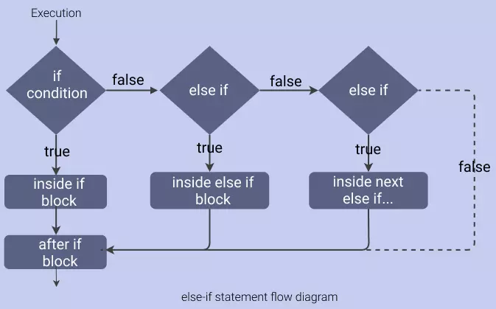
Flowchart of JavaScript else if statement

Slide 9
else if syntax
if (condition) {
// executes this block if the condition is true
}
else if (condition) {
// executes this block if the condition is false
}
... (more else if blocks)
else {
// executes this block if the condition is false
}

Slide 10
Multiple Alternative if Statements
Example 1:
if (score >= 90)
grade = ‘A’;
else
if (score >= 80)
grade = ‘B’;
else
if (score >= 70)
grade = ‘C’;
else
if (score >= 60)
grade = ‘D’;
else
grade = ‘F’;

Slide 11
Example 2
var a = 15;
if (a == 10) {
console.log("True, a = 10");
}
else if (a == 15) {
console.log("True, a = 15");
}
else {
console.log("False, a is not equal to 10 or 15");
}

Slide 12
Example 3
let today = new Date().getDay();
if (today == 0) {
console.log("Sunday!");
}
else if (today == 1) {
console.log("Monday!");
}
else if (today == 2) {
console.log("Tuesday!");
}
else if (today == 3) {
console.log("Wednesday!");
}
else if (today == 4) {
console.log("Thursday!");
}
else if (today == 5) {
console.log("Friday!");
}
else {
console.log("Saturday!");
}

Slide 13
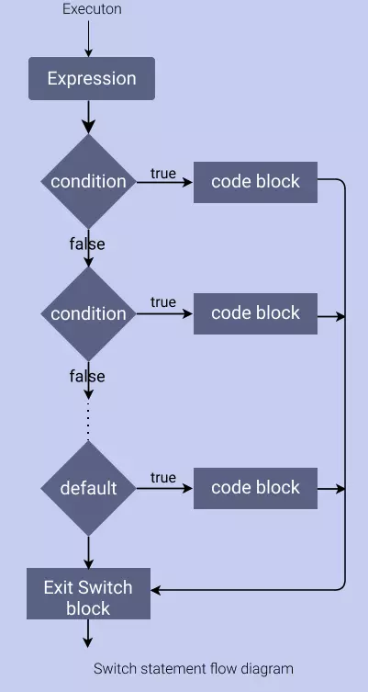
Flowchart of switch statement

Slide 14
switch Statements
switch (variable-name)
{
case value1:
Execute stmt1;
break;
case value2:
Execute stmt2;
break;
case valueN:
Execute stmtN;
break;
default:
Execute last;
}

Slide 15
Example 1:
let operation = "cube";
let num = 5;
switch(operation) {
case "square":
console.log(num * num);
break;
case "cube":
console.log(num * num * num);
break;
case "square root":
console.log(Math.sqrt(num));
break;
default:
console.log(num);
}

Slide 16
Example 2:
let message = "Hello";
switch(message) {
case "Hola":
console.log("Found message. Message: Hola");
break;
case "Hello":
console.log("Found message. Message: Hello");
break;
default:
console.log("Did not found the message!");
}

Slide 17
switch (new Date().getDay()) {
case 0:
console.log("Sunday");
break;
case 1:
console.log("Monday");
break;
case 2:
console.log("Tuesday");
break;
case 3:
console.log("Wednesday");
break;
case 4:
console.log("Thursday");
break;
case 5:
console.log("Friday");
break;
case 6:
console.log("Saturday");
break;
default:
console.log("Invalid day");
}

Slide 18
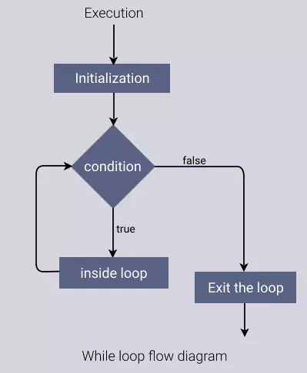
The flow diagram below shows the execution of the while loop.

Slide 19
Decision Making and Looping
Example 1:
1) While Loop
while (condition is true)
{
// loop-body;
}
e.g.
var a = 20;
while(a>10)
{
document.write(“Javascript”);
a--;
}

Slide 20
Example 2:
var count = 0;
while (count < 5) { // Condition
console.log(count);
count++; // updating variable i
}

Slide 21
Decision Making and Looping
2) do while Loop
do
{
// Loop body;
}
while (condition is true);
e.g.
let a = 0;
do
{
document.write(a);
a++;
}while(a<50);

Slide 22
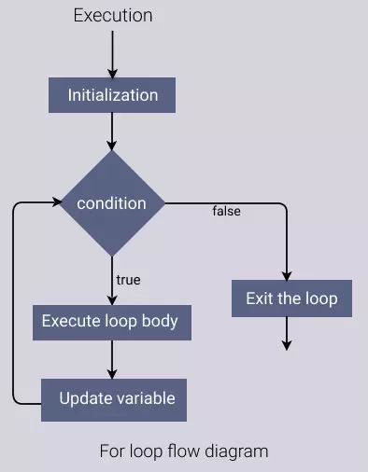
Flow Diagram - How for loop works

Slide 23
Decision Making and Looping
3) for Loop
for(initialization; condition; incr/decrement)
{
// Loop body;
}

Slide 24
e.g.
1)let a;
for(let a=0; a<=10;a++)
{
document.write(a);
}
OR
let a;
for(let a=0;a<10;a++)
console.log(a);
2)for (var i = 1; i <= 10; i++) {
console.log(i * i);
}

Slide 25
Example 1 - Nested for loop with no initialization
var i = 0;
for (; i < 5; i++) {
console.log(i);
}

Slide 26
Decision Making and Looping
4) for in Loop
The for/in statement loops through the properties of an object.
The block of code inside the loop will be executed once for each property.
Syntax:
for (var in object)
{
code block to be executed
}
Parameter Values
Parameter Description
var Required. A variable that iterates over properties of an object
object Required. The specified object that will be iterated

Slide 27
break Statement
The break statement can also be used to jump out of a loop.
The break statement breaks the loop and continues executing the code after the loop (if any):
Syntax:
jump-statement;
break;
Ex:
for (i = 0; i < 10; i++)
{
if (i === 3)
{ break; }
text += "The number is " + i + "<br>";
}

Slide 28
break Statement
Output:
The number is 0
The number is 1
The number is 2

Slide 29
continue Statement
The continue statement breaks one iteration (in the loop), if a specified condition occurs, and continues with the next iteration in the loop.
Syntax:
jump-statement;
continue;
Ex:
for (i = 0; i < 10; i++)
{
if (i ==3)
{ continue; }
text += "The number is " + i + "<br>";
}

Slide 30
continue Statement
Output:
The number is 0
The number is 1
The number is 2
The number is 4
The number is 5
The number is 6
The number is 7
The number is 8
The number is 9

